Slide 1
FLIGHT PRICE PREDICTION
-Manpreet Kaur Arora

Slide 2
PROBLEM STATEMENT
The flight prices keep changing on a daily basis.
The flight prices are unpredictable but there are chances we can predict the same given a few past datapoints.
We have a 2019 dataset spanning across the months March to June.

Slide 3
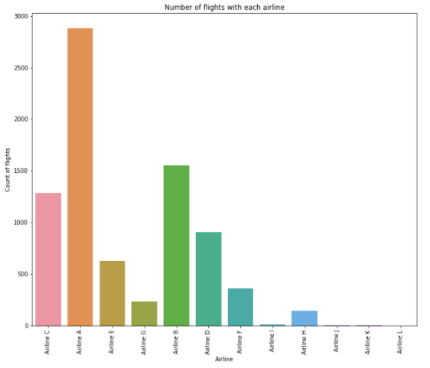
Airlines
The dataset contains data from 12 different Airlines.

Slide 4
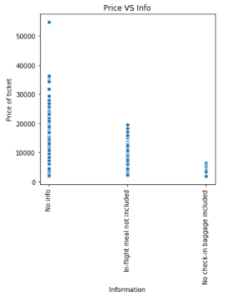
Additional_Info
The Additional_Info column has extra details about the flight. Observing closely we realize that a few datapoints belong to the same date. So, we merge them with ‘No Info’ and we are left with only 3 unique values.

Slide 5
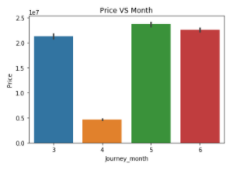
Price VS Month
May has the highest sales of flight tickets and April has the lowest.

Slide 6
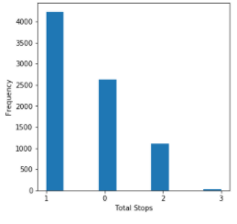
Total_Stops
We observe that maximum flights have only one stop during the entire journey.

Slide 7

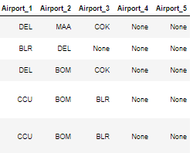
Route
The ‘Route’ columns mainly tell us that how many cities they have taken to reach from source to destination .This column is very important because based on the route they took will directly effect the price of the flight So We split the Route column to extract the information .Regarding the ‘Nan’ values we replace those ‘Nan’ values with ‘None’ .

Slide 8
PIPELINE
The columns Airline, Source, Destination, Info, Total_Stops, Airports are encoded to be fit for the ML model.
The dataset has been split into train data and test data in the ratio 80:20
4 different Models were fit to the final dataset and it was concluded that XGBoost model gave the lowest RMSE Score.
The parameters of the XGBoost model were changed and experimented upon to conclude the best fitting model.

Slide 9
RMSE SCORES
ML MODEL | RMSE SCORE
Linear Regression | 2479.294
Random Forest | 2057.045
Decision Tree | 2218.049
XGBoost | 1349.200

Slide 10
XGBoost model was finally used to predict the Prices of the test dataset and the values were stored in a CSV file.
THANK YOU

